Slide 1
Literature Survey

Slide 2
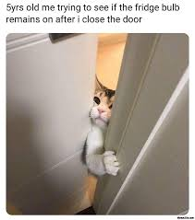
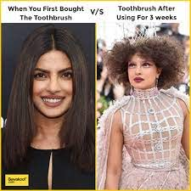
Hateful Memes
vs
Non Hateful Memes
Hateful Memes

Slide 3
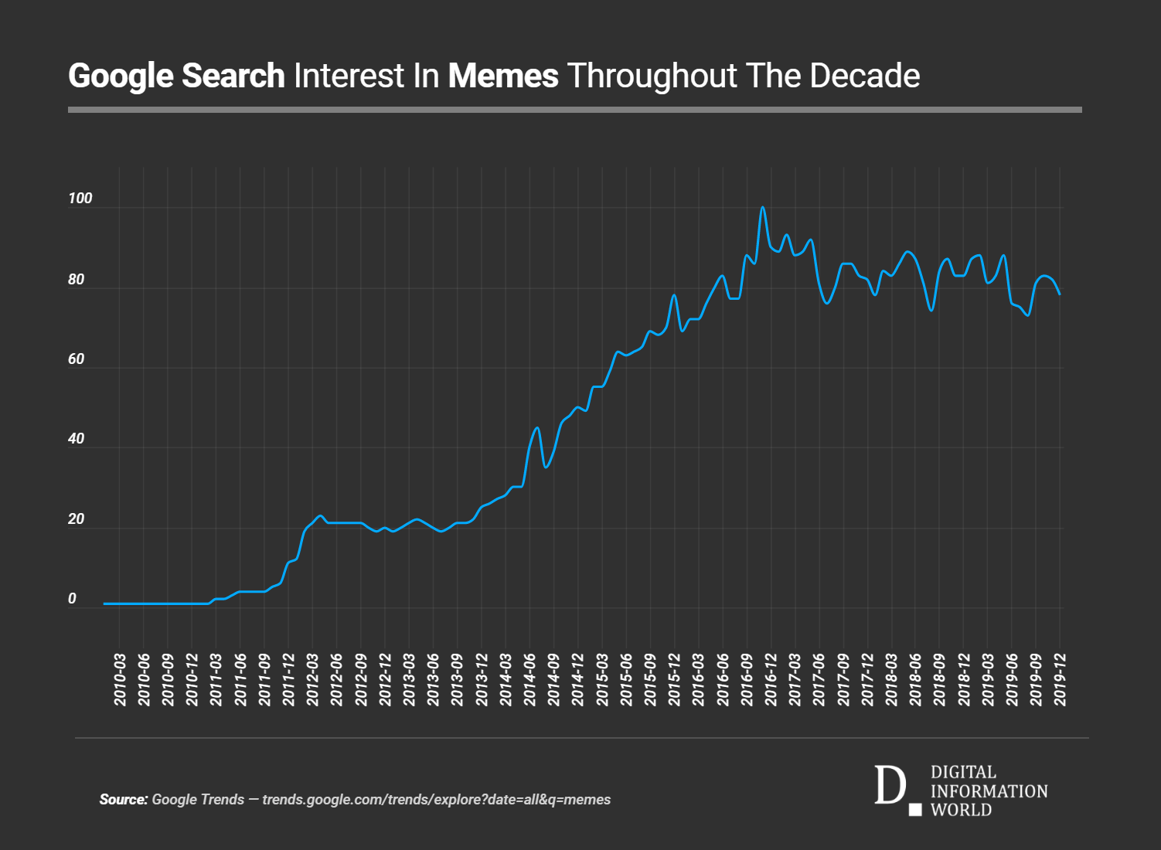
Rise of memes

Slide 4
Why to classify between hateful memes and fine memes?
How memes have made it easier to spread anger and hate?

Slide 5
Datasets Available

Slide 6
Works done

Slide 7
Conclusion

